Slide 1
Choice Model and Preference learning
STAT4830: Numerical Optimization for Data Science and Machine Learning
Shuhan Zhang zhang19@sas.upenn.edu
Xinyu Zhang joyxyz@sas.upenn.edu
Lexuan Chen amy0305@sas.upenn.edu

Slide 2
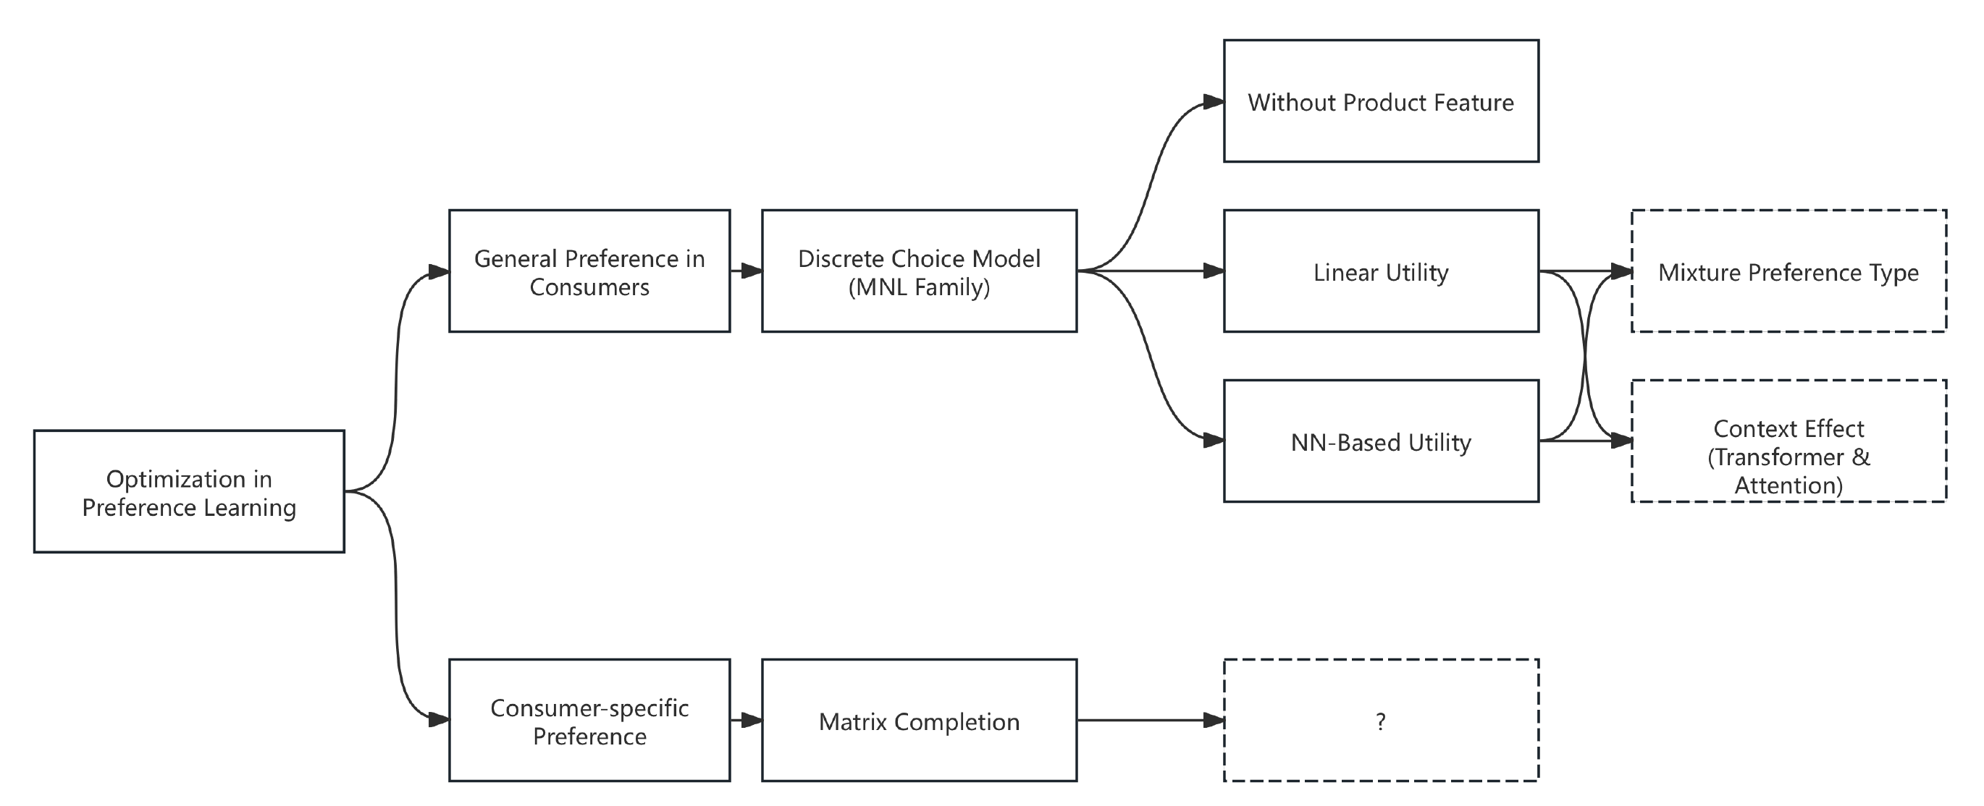

Outline
Population
Frank-Wolfe Algorithm
NN-Based Utility
Matrix Completion
Individual

Slide 3
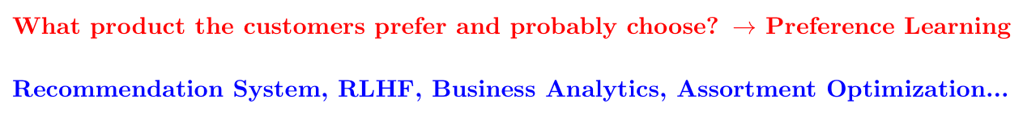
Preference Learning
Preference learning : to model and predict an individual's preferences or choices from a set of alternatives based on available data.
Two types: population-wise & individual-wise
Lots of applications.

Slide 4
Problem Objective: What Problem Are We Solving?
Predict consumer hotel preference from personalized offer sets
Estimate perceived utility of each hotel based on features
Calculate choice probabilities
Minimize error between predicted and actual selection outcomes
Consumer Features
Hotel Features
Utility Model
Probability of Choice

Slide 5
An Example for Choice Model: Fruit Selection
Fruit (Sugar level) | Consumer | Offer Set | Choice
Apple (4) | A (diabetes) | Apple, Banana and Pear | ?
Banana (5) | B (no diabetes) | Apple and Banana | ?
Pear (3)
Objective: predict the consumer’s choice
Simple Example
The Complexity: Scale up to thousands of products with various features, consumers with a range of personal features and much larger offer sets,
Predicting the choice becomes much more challenging!

Slide 6

Why Is This Problem Important?
Online platforms like Expedia present thousands of options — smart filtering is crucial
It translates abstract consumer behavior into a quantifiable, interpretable optimization model grounded in economic theory.
Real-world constraints: limited user visibility, heterogeneous preferences, and missing data

Slide 7
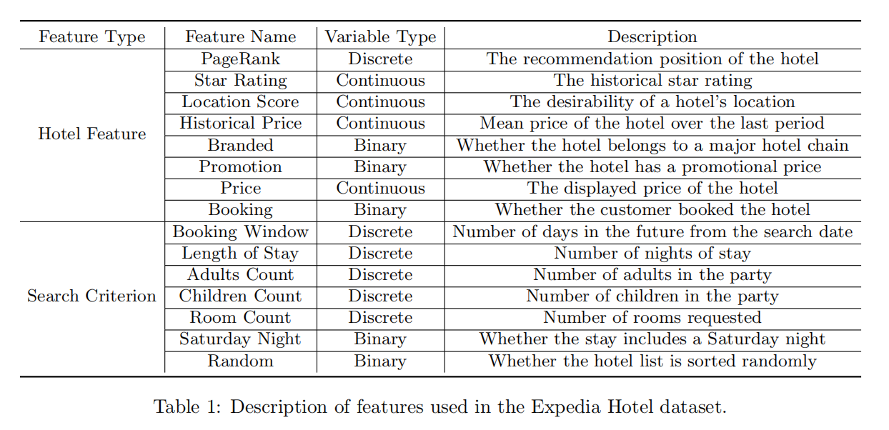
Experiments: Expedia Dataset

Slide 8
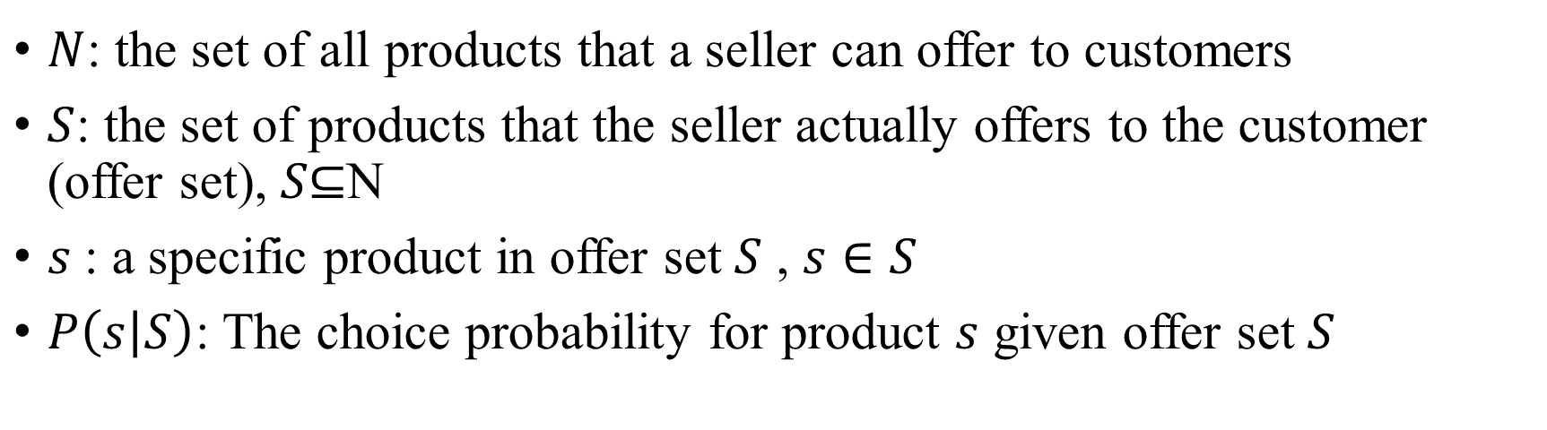
General Setup
$N$: the set of all products that a seller can offer to customers
$S$: the set of products that the seller actually offers to the customer (offer set), $S\text{⊆}\text{N}$
$s$: a specific product in offer set $S$ , $s∈S$
$P\left(s | S\right)$: The choice probability for product $s$ given offer set $S$

Slide 9
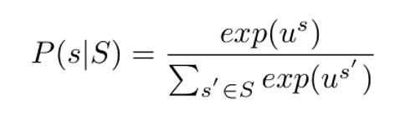
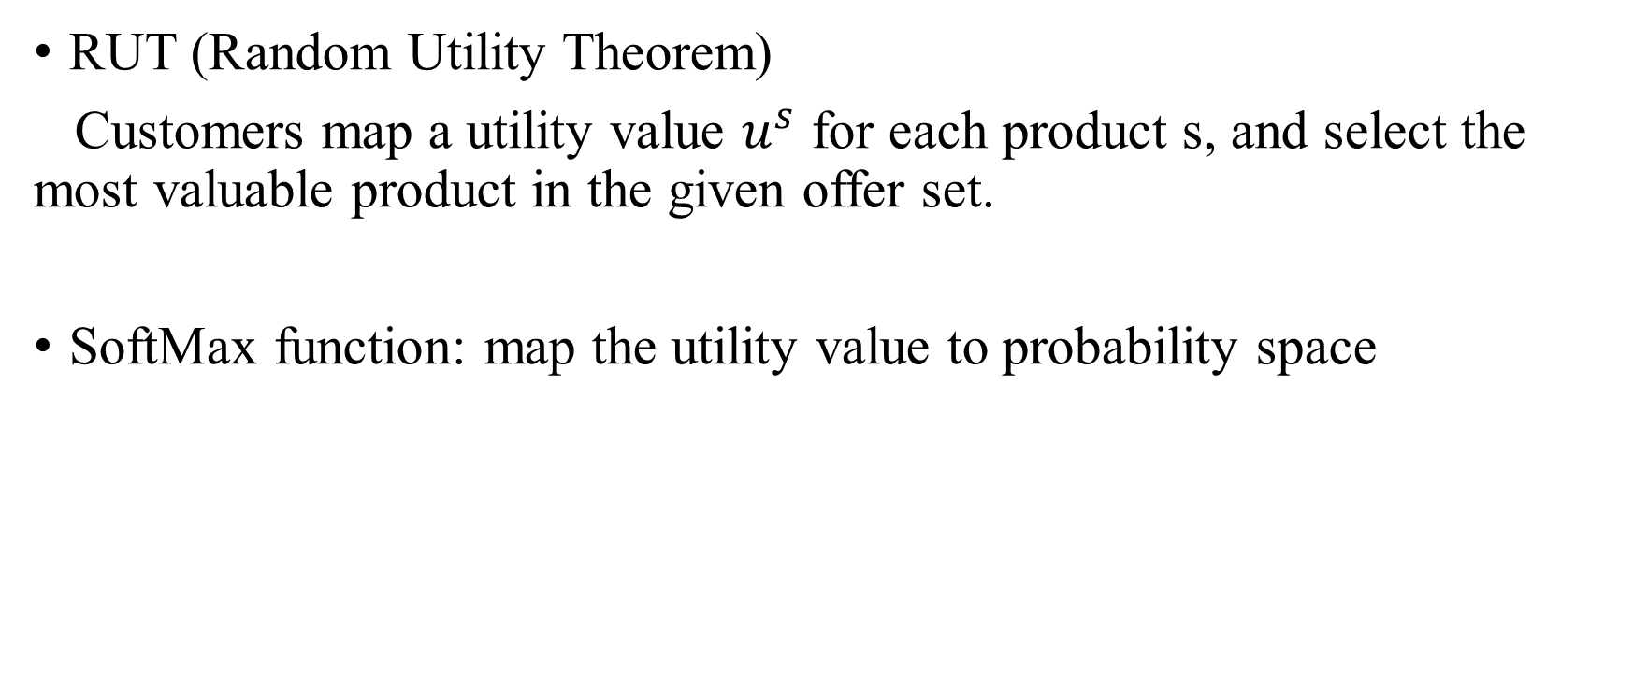
Random Utility Theorem and MNL Model
RUT (Random Utility Theorem)
Customers map a utility value $u^{s}$ for each product s, and select the most valuable product in the given offer set.
SoftMax function: map the utility value to probability space

Slide 10
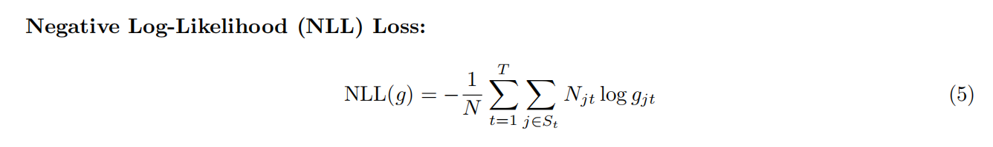
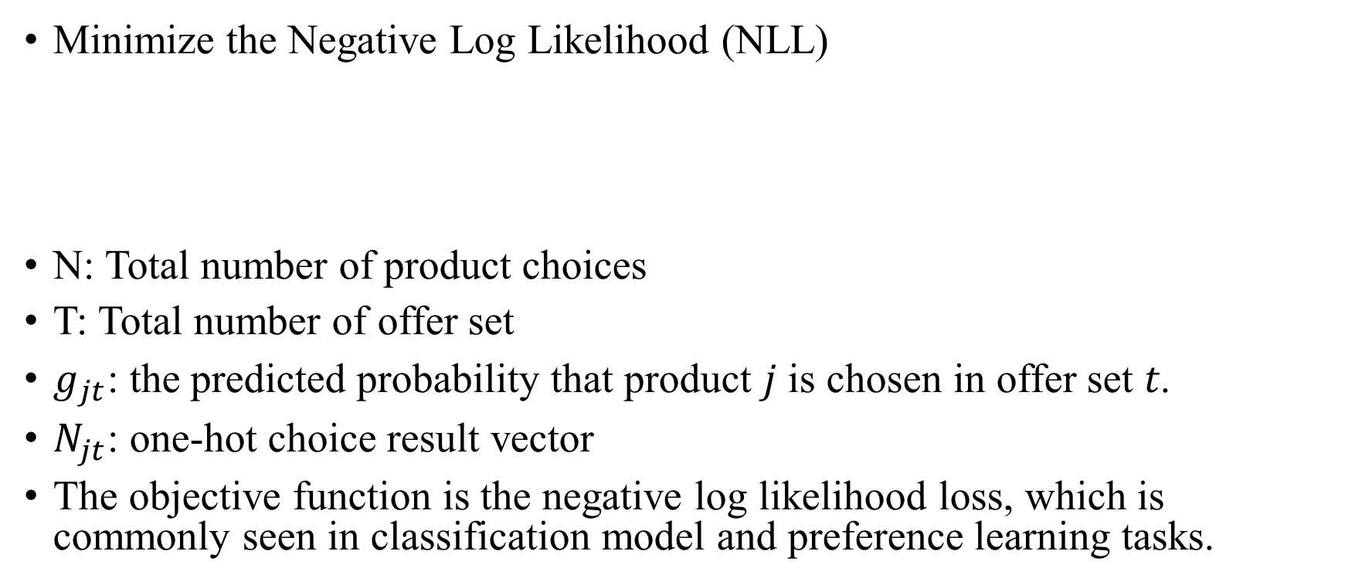
Optimization Objective
Minimize the Negative Log Likelihood (NLL)
N: Total number of product choices
T: Total number of offer set
$g_{jt}$: the predicted probability that product 𝑗 is chosen in offer set 𝑡.
$N_{jt}$: one-hot choice result vector
The objective function is the negative log likelihood loss, which is commonly seen in classification model and preference learning tasks.

Slide 11
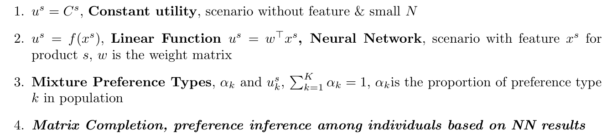
Model Candidate

Slide 12
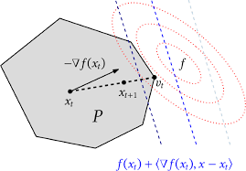
Mixture Preference Learning with Frank-Wolfe Algorithm
Shuhan Zhang

Slide 13
Outline
Existing literature drawbacks
Problem and optimization objective
Algorithm framework & support finding
Experiment setup
Results
Discussion

Slide 14
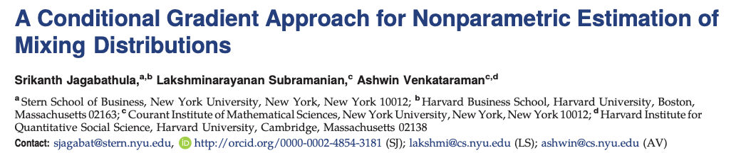

Reference
The idea are inspired by paper: A Conditional Gradient Approach for Nonparametric Estimation of Mixing Distributions
We want to explore the effect of replacing linear utility function with NN-based function. Will it improve the performance?

Slide 15
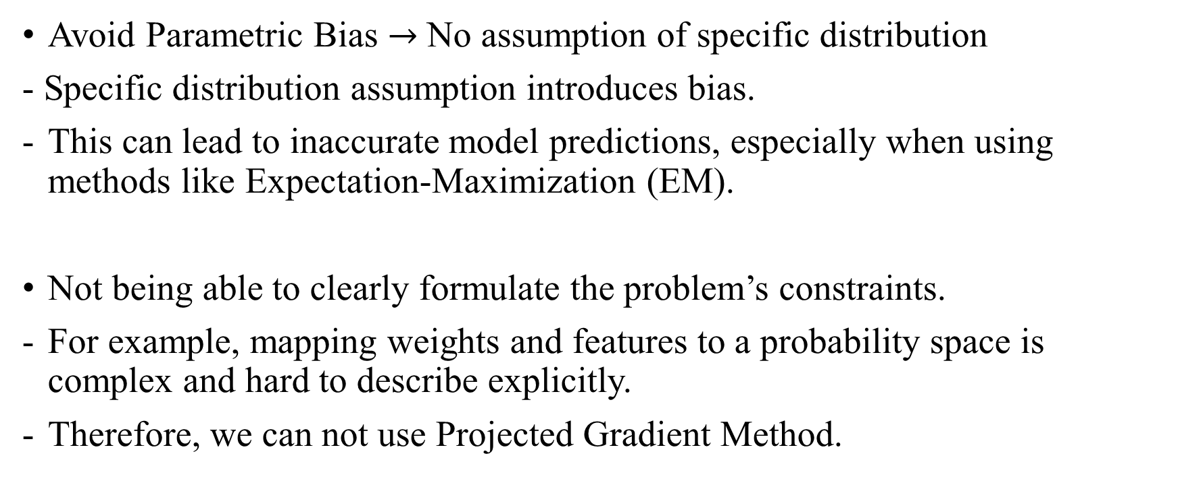
Why do We Need Frank-Wolfe Algorithm?
Avoid Parametric Bias $→$ No assumption of specific distribution
- Specific distribution assumption introduces bias.
This can lead to inaccurate model predictions, especially when using methods like Expectation-Maximization (EM).
Not being able to clearly formulate the problem’s constraints.
For example, mapping weights and features to a probability space is complex and hard to describe explicitly.
Therefore, we can not use Projected Gradient Method.

Slide 16
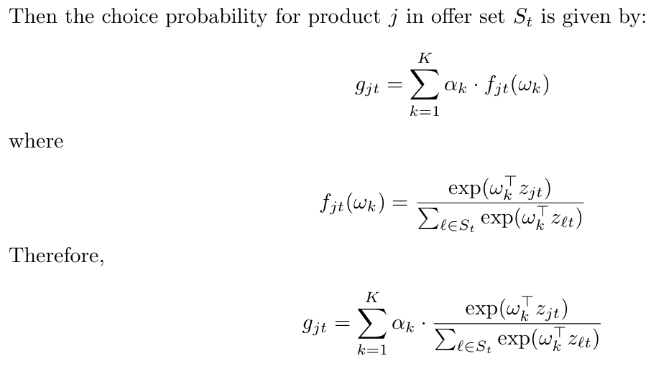
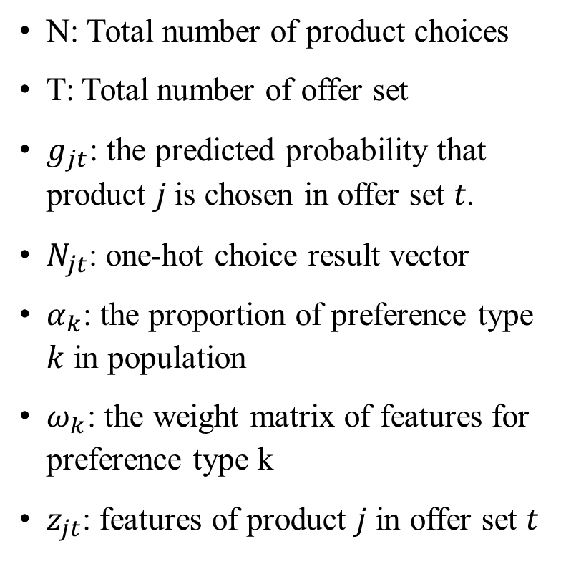
Optimization Objective
Negative Log-Likelihood (NLL) Loss
N: Total number of product choices
T: Total number of offer set
$g_{jt}$: the predicted probability that product 𝑗 is chosen in offer set 𝑡.
$N_{jt}$: one-hot choice result vector
$α_{k}$: the proportion of preference type $k$ in population
$ω_{k}$: the weight matrix of features for preference type k
$z_{jt}$: features of product $j$ in offer set $t$

Slide 17
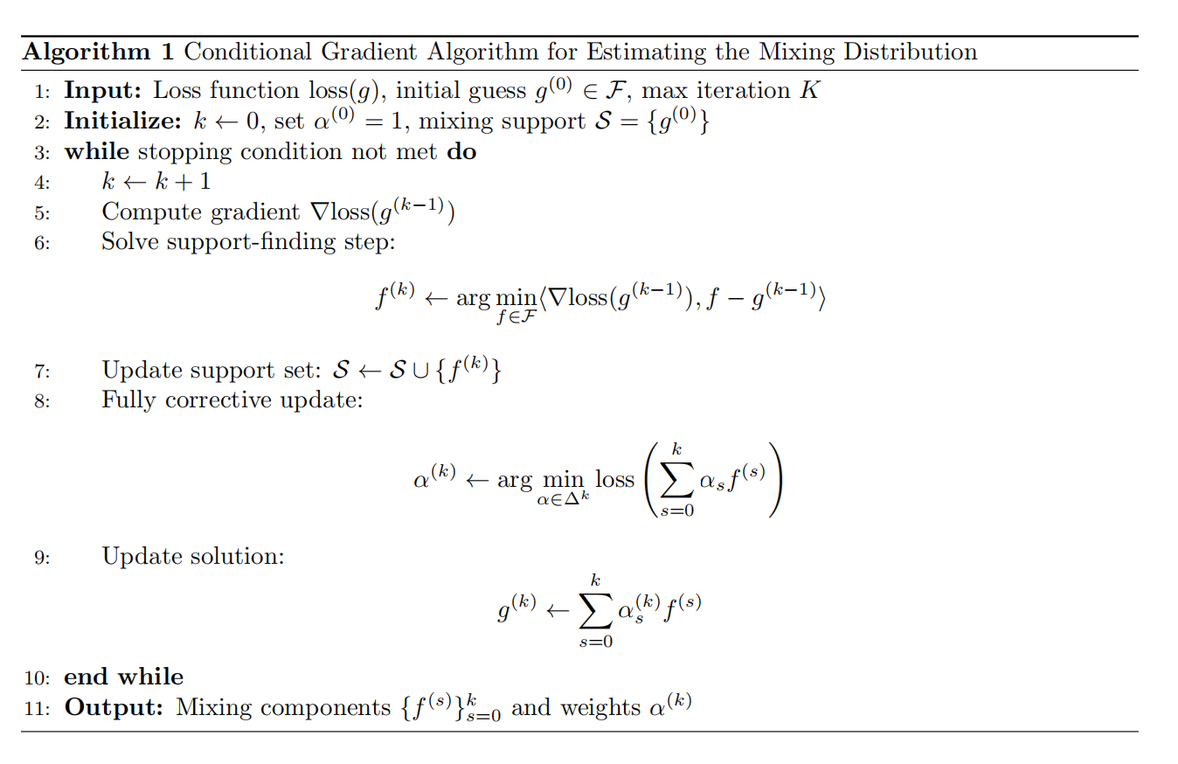
Algorithm framework

Slide 18

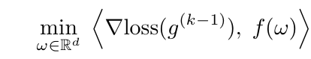
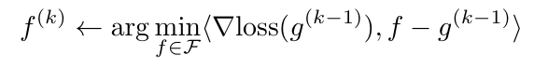
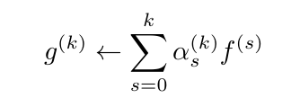
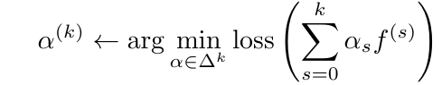
Finding the direction the mixture distribution should develop
Refit the proportion of each mixture component

Slide 19
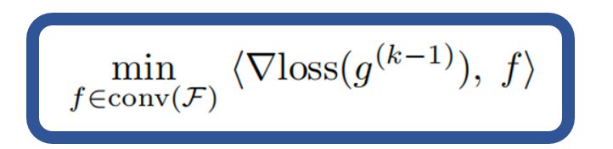
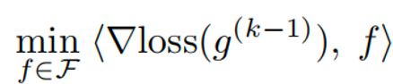
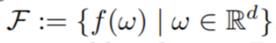
Support Finding = Finding new preference type
Linear minimization problem over the convex hull conv(F) of atomic likelihood vectors
Optimum always achieved at one of its extreme points！
Extreme lies in F.

Slide 20
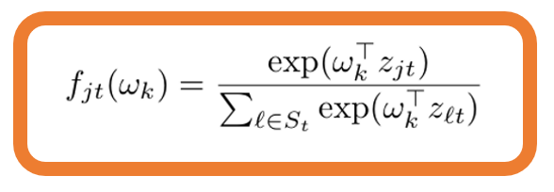
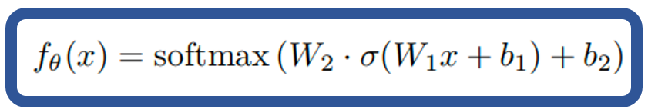
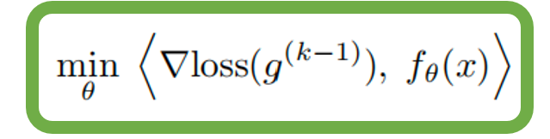
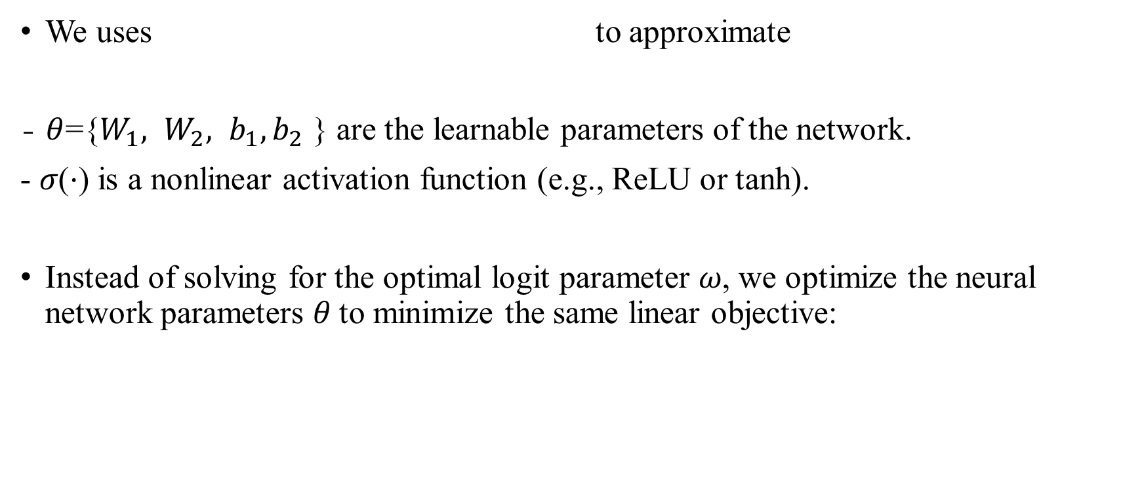
One Step Further: NN-based Support Finding
We uses to approximate
- $θ$={$W_{1}, W_{2}, b_{1}, b_{2}$​ } are the learnable parameters of the network.
- 𝜎(⋅) is a nonlinear activation function (e.g., ReLU or tanh).
Instead of solving for the optimal logit parameter 𝜔, we optimize the neural network parameters 𝜃 to minimize the same linear objective:

Slide 21
Experiments: Expedia Dataset

Slide 22
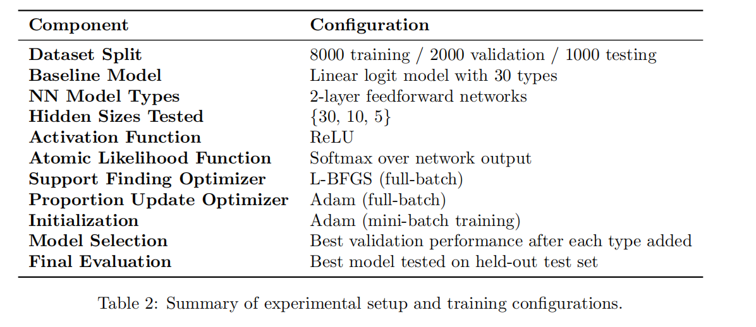
General Settings

Slide 23
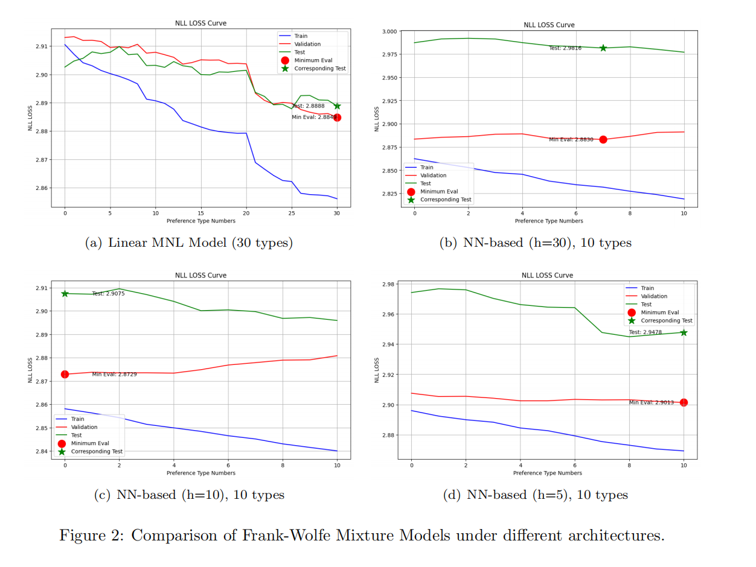
Results

Slide 24
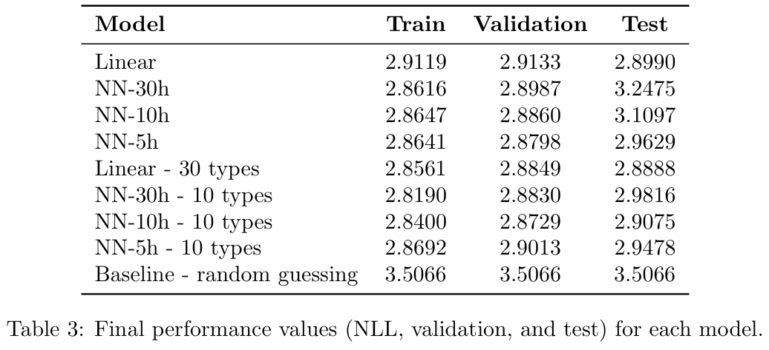
Results: Linear Mixture Model Wins

Slide 25
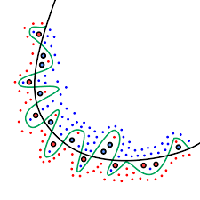

Discussion: Overfitting

Slide 26
Discussion: Analysis
Limited Data Size
- Expedia: A limited number of training examples.
- Neural networks typically require large-scale data to generalize well.
Poor generalization, even with strong regularization.
Under-regularized Proportions
- We didn't penalize model complexity during the proportion update step.
- Overfitting: complex types receive large weights in the mixture even if they overfit the training data.
- Future work may include sparsity-inducing penalties or entropy regularization in the weight optimization process.

Slide 27
Discussion: Analysis
Inherent Linearity of Human Decision Boundaries
- Human preferences in real-world decision-making (e.g., hotel booking) often follow relatively linear structures.
- Customers tend to prefer cheaper hotels, higher star ratings, or prominent locations.
- In such scenarios, linear models may already capture most of the signal, and introducing nonlinearity could add noise and increase the risk of overfitting.

Slide 28
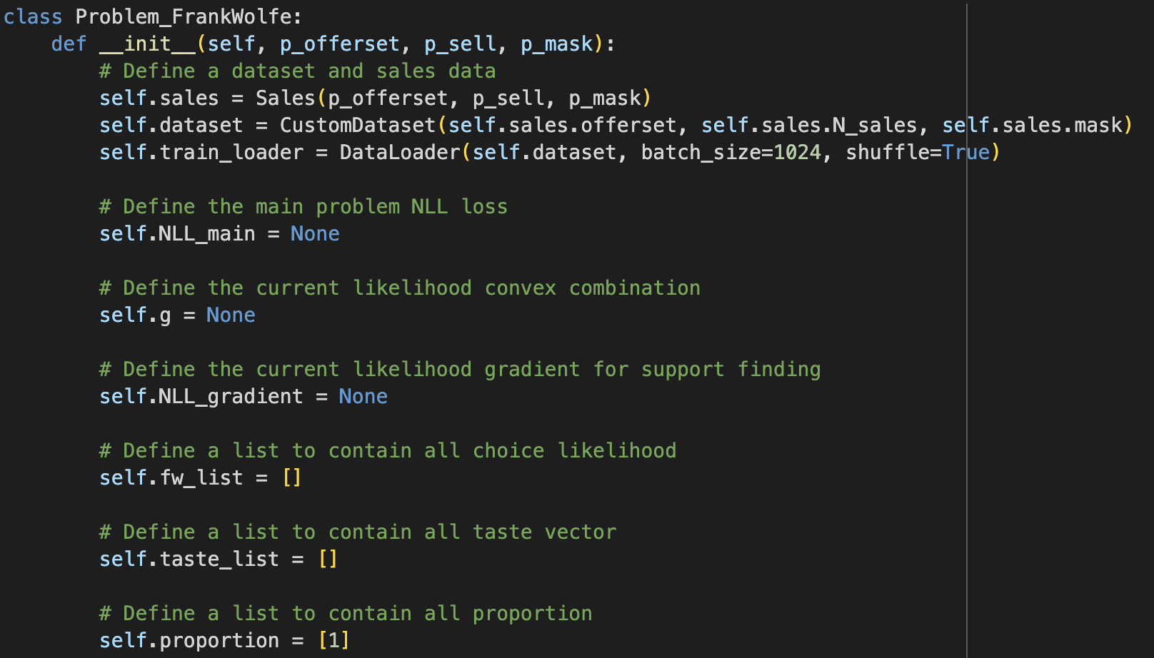
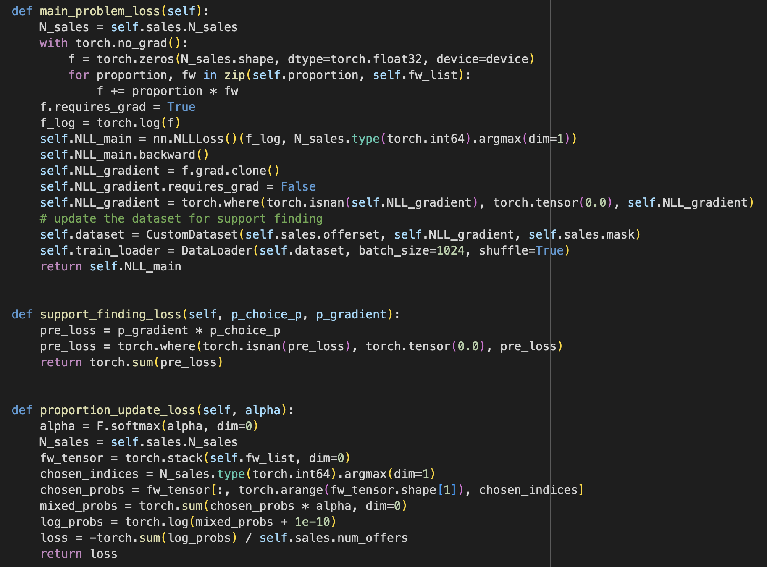
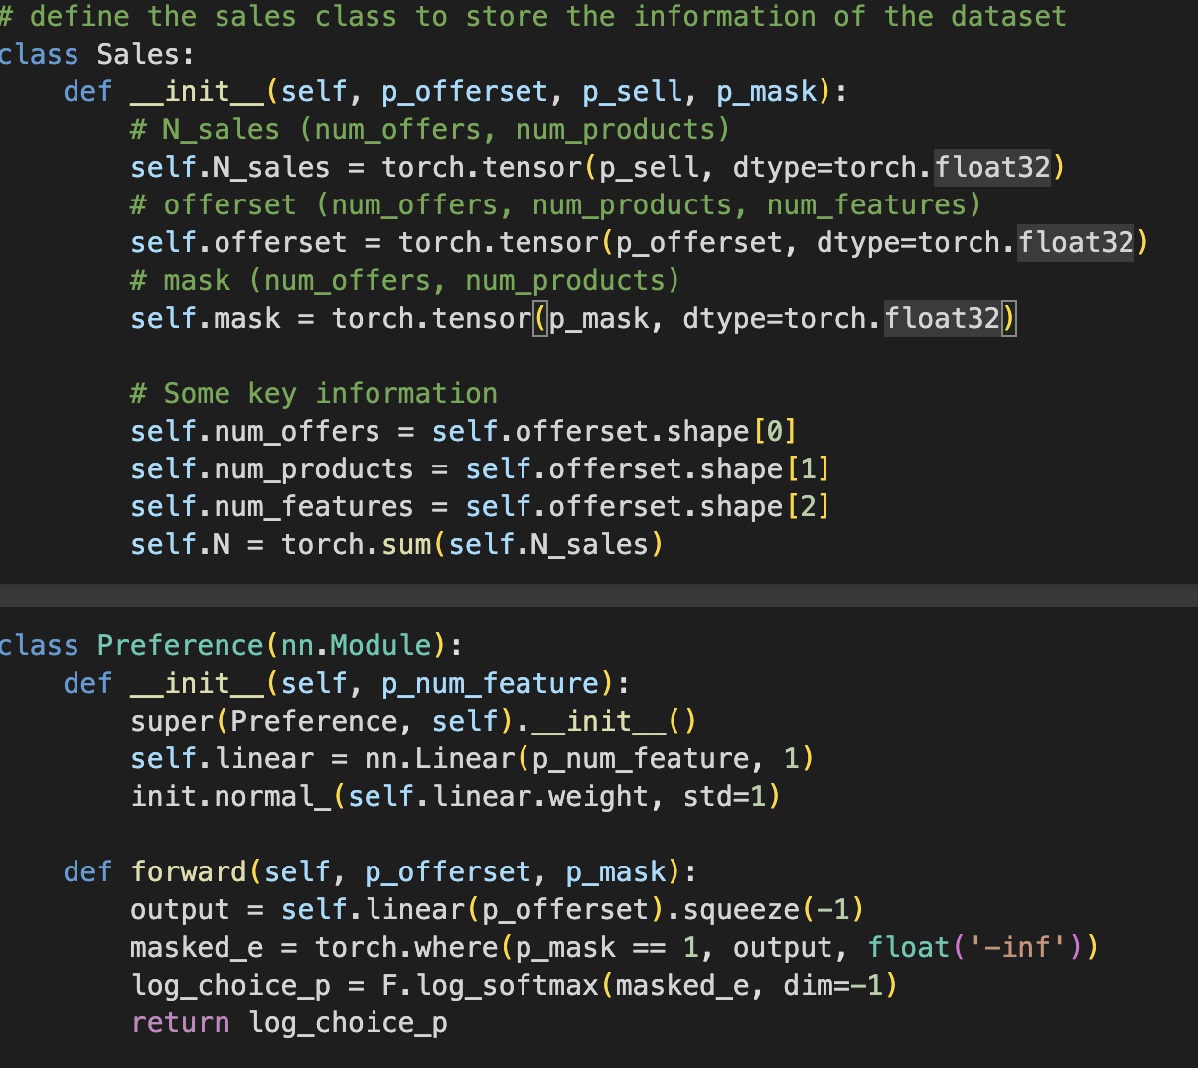
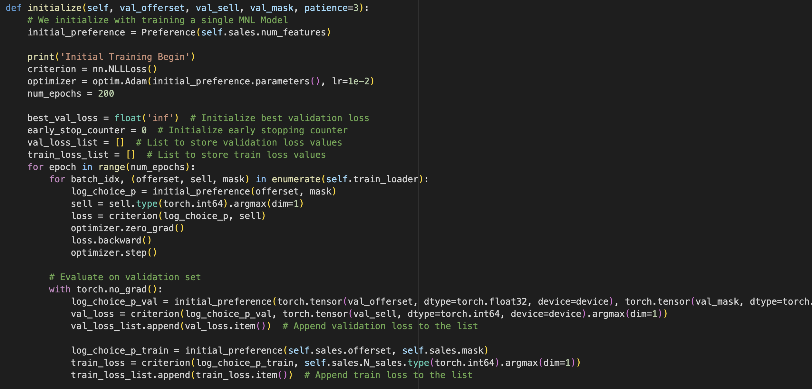
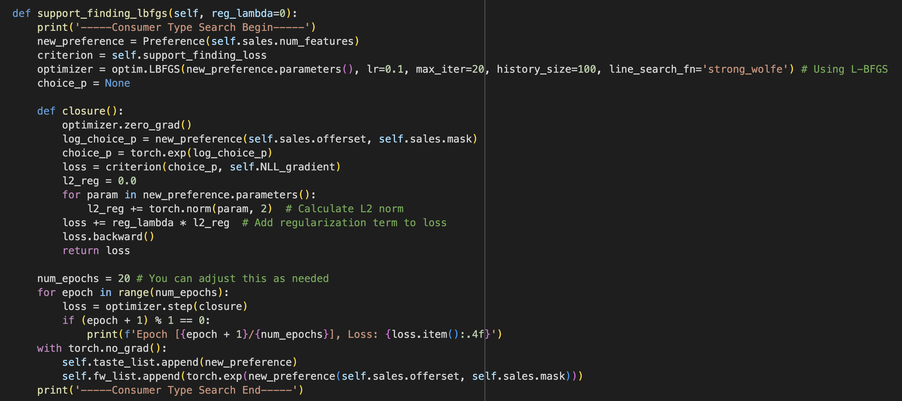
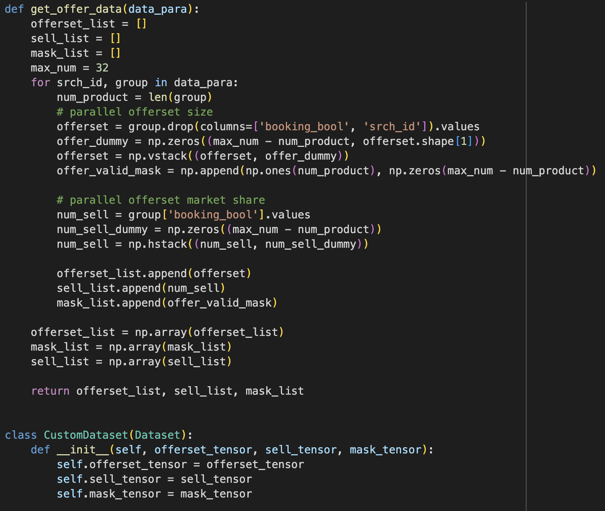
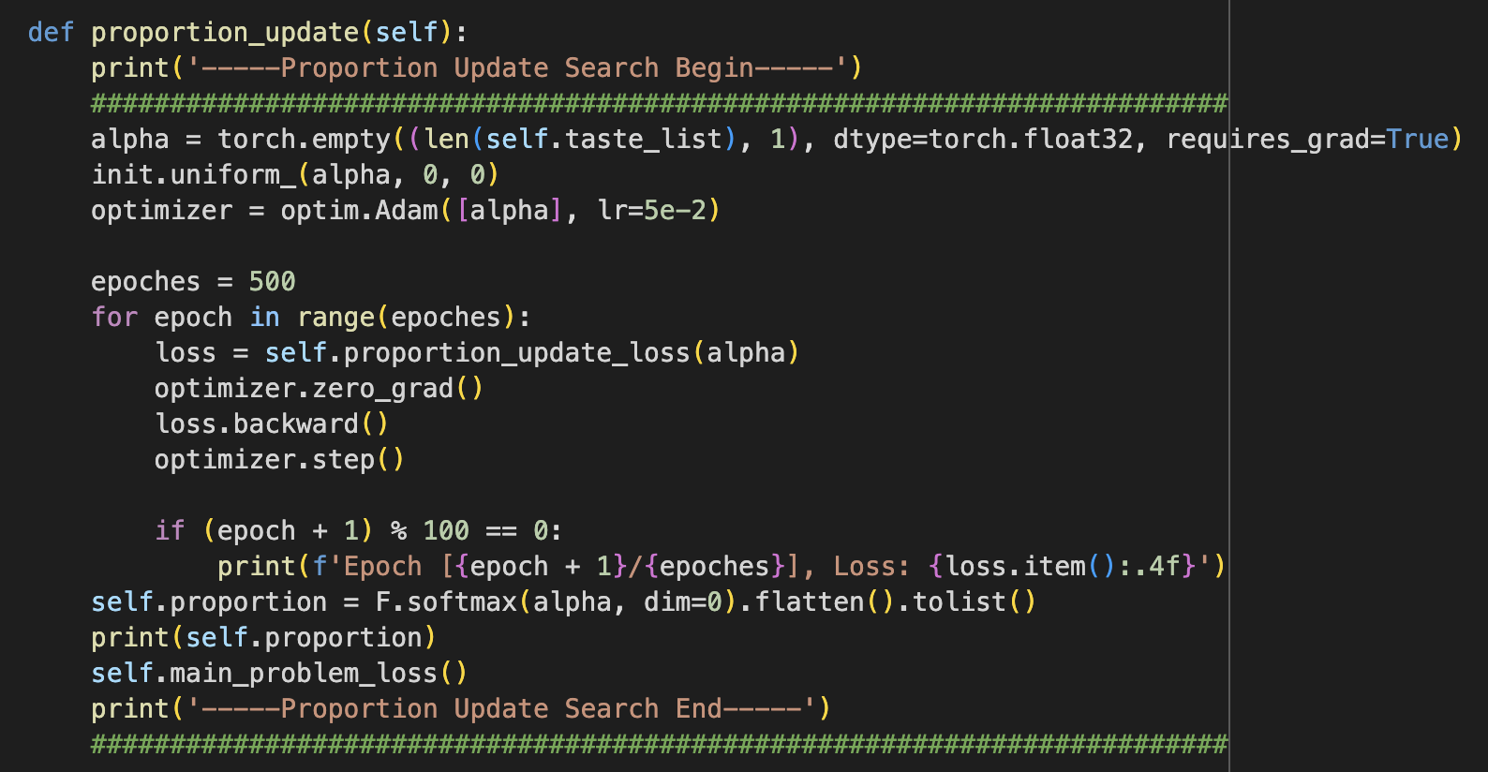
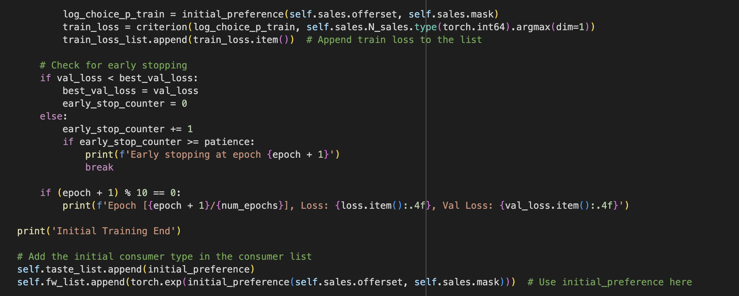
Code Showing

Slide 29
Preference Learning A New Trial --- Matrix Completion
Lexuan Chen

Slide 30
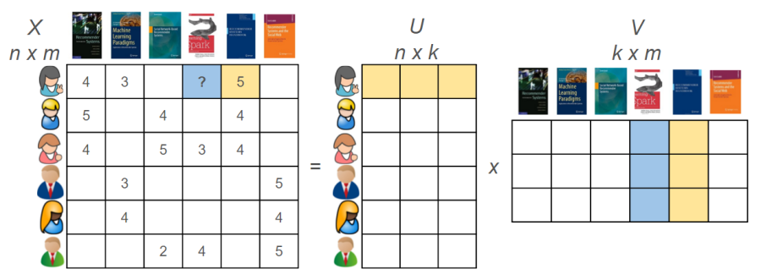
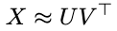
Matrix Completion
User Matrix
Item Matrix
Rating Matrix
Modeling assumption
T
X ∈R^{n×m}
U ∈R^{n×k}
V ∈R^{m×k}
k: rank of X
First matrix ---- each row belongs to an individual
Second matrix ---- each column belongs to an item
Netflix Dataset (Film Puzzle)
Complete U and V
Predict completed X
Notes:
尝试利用Expedia数据集生成与Netflix相似的数据环境 并应用矩阵补全

Slide 31
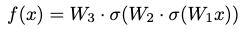
MNL with 3 layer NN-based Model
We use a 3-layer feedforward neural network to model the utility score of each hotel given a consumer’s search offer set.
Utility Score Generation
Input Features
Joint feature vector of a (consumer, hotel) pair
Consumer-side: srch_length_of_stay, srch_booking_window, etc.
Hotel-side: price_usd, location_score, promotion etc.
Layer | Description
Layer 1 | Linear: R^{d} $→$ R¹⁰⁰ followed by Sigmoid
Layer 2 | Linear: R¹⁰⁰ $→$ R¹⁰⁰ with Sigmoid
Output | Linear: R^{d} $→$ R¹, outputs utility score

Slide 32
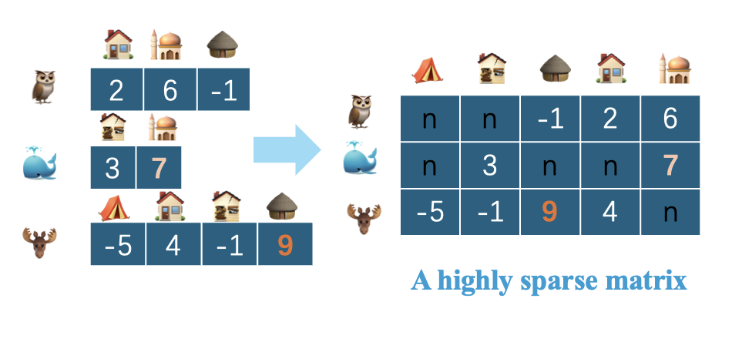
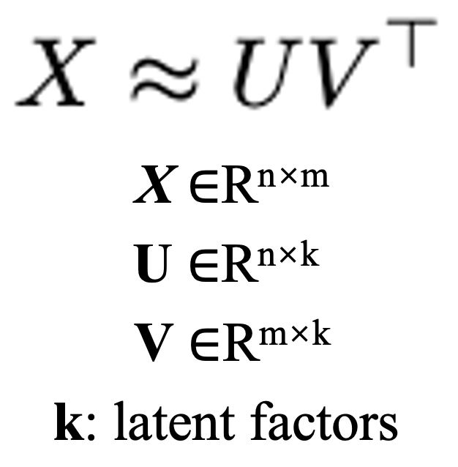
Original Matrix
“item bias”
“individual bias”
Train/Test Split
Matrix View of the Utility from all (consumer, hotel)
Pairs
Expedia Dataset
(Hotel Puzzle )
Consumers’ Utility over Their Own Offer Sets
Use matrix completion techniques in Expedia:
· Recover missing preferences
· Keep recovered matrix low-rank (k)
Goal
Notes:
Explore whether matrix completion techniques can recover missing preferences and enhance ranking quality in Expedia sparse setting.

Slide 33
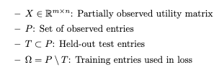
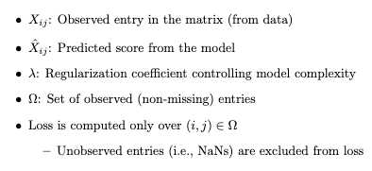
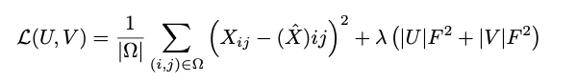
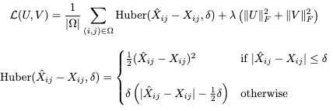
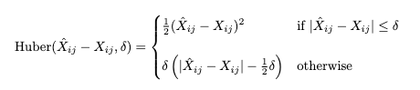
Optimization Objectives
Test set is never seen during training and is used to evaluate generalization on real missing entries.
Train/Test Split
Two types loss functions
· MSE
Use both in synthetic data and real-world datasets
· Huber
Used in sparse, noisy real- world settings for robustness.
Notes:
Huber— blending MSE’s sensitivity with MAE’s resistance to outliers. Based on the original observed entry set P, we randomly hold-out test entries represented by T, substituting entries in T by Nans, then we derive the final observed training set omega, which is used to compute loss, while test set can never be seen during training.

Slide 34
Two-stage Experiment
· Singular Value Thresholding (SVT)
· Gradient Descent-based Factorization with Different update strategies
Synthetic and Benchmark Datasets
Try different methods in Synthetic Data
Use Netflix Dataset to Validate
Real world Expedia Dataset
Generate Original Score
Derive Original Matrix
Implement Matrix Completion
Method List
Benchmark our best matrix factorization method against a popular SVT baseline on the Netflix dataset from Kaggle.
Baseline
Notes:
因为我们没法给每个消费者和item分类，我们采取了更直接的方式 引入 Bias

Slide 35
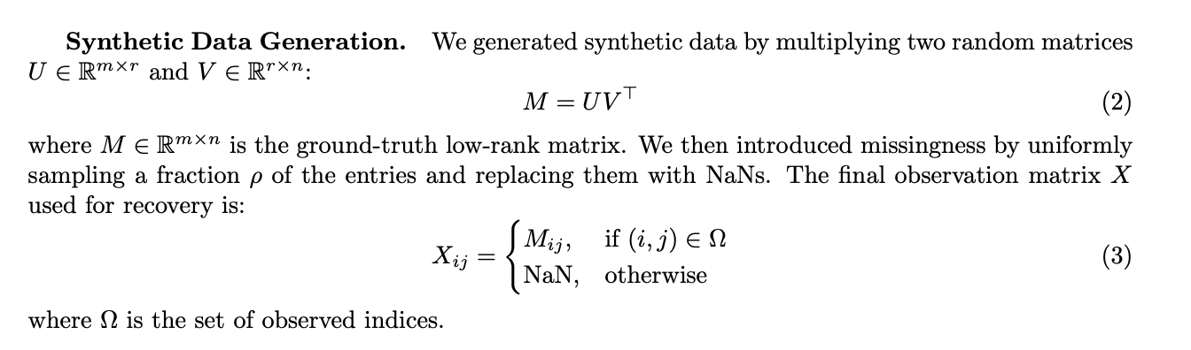
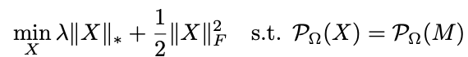

Stage 1：Synthetic and Benchmark Datasets
· Synthesis Method
Traditional SVT methods are slow due to iterative singular value thresholding, and often yield overly high-rank solutions that compromise interpretability.
· First Try: Singular Value Thresholding (SVT)
A convex relaxation of the matrix completion problem

Slide 36





Stage 1：Synthetic and Benchmark Datasets
· Gradient Descent-based Factorization
Prediction formula
Global bias
User bias
Item bias
Bias-aware initialization to extract the influence of users’ and items’ individual characteristic
Different update strategies
Small Gaussian noise is added to better model the real world data
🤣🤣🤣
We adopt Adam for downstream real-world matrix completion tasks.
Winner: Adam optimizer

Slide 37





Stage 1： Netflix Validation
Netflix Benchmark: Adam vs SVT
Strong real-world performance → gave us confidence to apply the method to Expedia
· Netflix Grid Search
· Predictive Rankings

Slide 38



Stage 2：Matrix Completion in Expedia
· Expedia Grid Search
Empirically, grid search results showed that Huber consistently outperformed MSE in terms of final RMSE
· Discussion on Early Stopping
Early stopping triggered at epoch 27.
· Extreme sparsity of the matrix
· Noisy targets
· Learned user/item biases may have absorbed most variation → Latent factors converged quickly

Slide 39
Stage 2：Matrix Completion in Expedia
· Overall Reflections
Expedia’s matrix is extremely sparse (< 1%), below recovery thresholds
Scores are model-derived, not ground-truth feedback
Clustering users/items may improve coherence before completion
Even under sparsity and noise labels, matrix completion proved viable and interpretable.
References
• Y. Chi, “Low-rank matrix completion,” IEEE Signal Processing Magazine, vol. 35, no. 5, pp. 178–181, 2018.
• J.-F. Cai, E. J. Cand`es, and Z. Shen, “A singular value thresholding algorithm for matrix com-pletion,” arXiv preprint arXiv:0810.3286, 2008.
• O. Golden, “Netflix Problem – Singular Value Thresholding,” Kaggle Notebook, https://www.kaggle.com/code/odedgolden/netflix-problem-singular-value-thresholding/notebook

Slide 40
Self Critiques-Shuhan Zhang
What was the most surprising result or finding during the project?
The most surprising finding was that neural networks performed worse than linear models on the preference learning task in terms of generalization. Despite their expressive power, neural networks were highly prone to overfitting in this setting. This revealed a key insight: neural networks are not universally superior, and there is no free lunch in machine learning. The inherent linearity in human decision-making gave linear models a natural advantage in this context.
Which specific lecture topic, concept, or technique from the course was most useful for your project? Explain how.
The lecture content on optimizers was particularly useful. In my project, I experimented with both L-BFGS and Adam, as well as different optimization strategies including full-batch and mini-batch training. Each optimizer and strategy affected performance differently, and understanding their mechanics helped me better tune my models for the specific task.

Slide 41
Self Critiques-Shuhan Zhang
How has your perspective on applying optimization in practice changed since the beginning of the course?
At the beginning of the course, I saw optimization as a standalone algorithmic problem. However, I’ve come to realize that optimization is deeply tied to the nature of the model and the task at hand. There is no universally best optimizer—each comes with its own trade-offs in convergence speed, generalization, and computational efficiency. Choosing and tuning an optimizer is as much an art as it is a science.
If you had two more weeks, what specific next step would you take on the project?
Given more time, I would apply the learned choice model to an assortment optimization problem—using predicted preferences to select product combinations that maximize overall utility or profit. This is a natural and practical downstream application of our model.
If you could restart the project, what is the single biggest change you would make to your approach or plan?
If I could start over, I would switch away from the Expedia dataset earlier for the matrix completion task. It turned out to be a poor fit for this purpose, and relying on synthetic data was not very informative. A better real-world dataset could have led to more meaningful insights.

Slide 42
Self Critiques-Xinyu Zhang
1. What was the most surprising result or finding during the project?
One of the most surprising findings was that the model will not improve greatly when increasing preference type after around 10 preference types while the optimal number of preference type is not fixed, showing that the data structure is different for the train-test split. Contrary to expectations, increasing the hidden layer size from 5 to 30 did not enhance predictive accuracy. The model with 30 hidden units overfit the training data and performed the worst on the test set.
2. Which specific lecture topic, concept, or technique from the course was most useful for your project? Explain how.
The most impactful concepts were the practical treatment of batch size in stochastic optimization and the application of PyTorch for model construction, which allowed for flexible experimentation with neural network architectures and gradient-based methods throughout the project.
3. How has your perspective on applying optimization in practice changed since the beginning of the course?
My initial view of optimization was algorithm-centric—focusing on mechanics like gradient descent or convexity. This course reshaped that view: I now understand that effective optimization is problem-specific, requiring alignment between the model structure, data characteristics, and the chosen optimizer. Selecting and tuning an optimizer is a process that balances computational efficiency, convergence behavior, and generalization.

Slide 43
Self Critiques-Xinyu Zhang
4. If you had two more weeks, what specific next step would you take on the project?
With two additional weeks, I would explore alternative neural network architectures—such as residual connections or attention mechanisms—rather than simply scaling hidden units. I would also incorporate explicit regularization strategies (e.g., dropout or weight penalties) to mitigate overfitting and improve out-of-sample robustness.
5. If you could restart the project, what is the single biggest change you would make to your approach or plan?
If I could restart, I would place greater emphasis on evaluating model generalization through cross-validation and ablation studies. Our early evaluations focused too heavily on final test accuracy, without systematically analyzing which components—model depth, type count, feature interaction—actually drove performance. A more principled experimental framework would have led to clearer insights and more reliable conclusions.

Slide 44
Self Critiques-Lexuan Chen
1. What was the most surprising result or finding during the project?
Despite extreme sparsity in observed entries, matrix completion via gradient descent produced reliable reconstructions. To make this scalable, I introduced a mini-batch training structure—adapting deep learning techniques to the matrix setting—which enabled efficient GPU acceleration without compromising accuracy. Through grid search, I further identified Huber loss as more robust than MSE under real-world noise, reinforcing the method’s reliability on behavioral data.
2. Which specific lecture topic, concept, or technique from the course was most useful for your project? Explain how.
PyTorch usage was critical—enabling all model training with GPU acceleration. Optimizer lectures helped me implement and analyze GD, Momentum, EMA, and Adam in matrix settings. Comparing their behavior under noise and scale deepened my understanding of practical optimization.
3. How has your perspective on applying optimization in practice changed since the beginning of the course?
I used to view optimization as simply solving equations—an abstract mathematical procedure aimed at finding the best solution. Through this course, I’ve come to see it as a full modeling framework: defining objectives, designing loss functions, analyzing gradient flows, and diagnosing convergence. Optimization is no longer just a tool, but a mindset—a dynamic and creative process central to structuring, training, and refining quantitative models.

Slide 45
Self Critiques-Lexuan Chen
4. If you had two more weeks, what specific next step would you take on the project?
Given two more weeks, I would cluster users and items based on behavioral features to improve local coherence before applying matrix completion. This allows low-rank assumptions to hold more effectively within each subgroup. Then, I would explore Transformer-based models to capture richer, non-linear interactions between user and item features within clusters. Compared to dot-product factorization, attention mechanisms can better model context-dependent preferences, potentially improving completion quality in sparse, high-dimensional settings.
5. If you could restart the project, what is the single biggest change you would make to your approach or plan?
I’d adopt PyTorch and GPU earlier, and introduce user/item clustering upfront to reduce heterogeneity in the data. This would allow subsequent models to focus on more coherent behavioral patterns, thereby enhancing the granularity and relevance of individual-level predictions.

Slide 46


